Slide 1
Chapter 6: Synchronization Tools

Slide 2
Chapter 6: Synchronization Tools
Background
The Critical-Section Problem
Some solutions and Peterson’s Solution
Hardware Support for Synchronization
Mutex Locks
Semaphores
Monitors
Liveness

Slide 3
Background
Processes can execute concurrently
  May be interrupted at any time, partially completing execution
Concurrent access to shared data may result in data inconsistency
  Need a way to ensure the orderly execution of processes
Example: Consider the consumer-producer problem
  To fill all the buffers, we can have an integer counter that keeps track of the number of full buffers.
  Counter is initially 0, and is
    incremented by the producer after it produces a new item
    decremented by the consumer after it consumes a item.

Slide 4
Producer and Consumer
while (true) { //producer
/* produce an item in next produced */
while (counter == BUFFER_SIZE)
; /* do nothing */
buffer[in] = next_produced;
in = (in + 1) % BUFFER_SIZE;
counter++;
}
while (true) { //consumer
while (counter == 0)
; /* do nothing */
next_consumed = buffer[out];
out = (out + 1) % BUFFER_SIZE;
counter--;
/* consume the item in next consumed */
}

Slide 5
Race Condition
counter++ could be implemented as
register1 = counter
register1 = register1 + 1
counter = register1
counter-- could be implemented as
register2 = counter
register2 = register2 - 1
counter = register2
Consider counter = 5 initially, then counter++ and counter- - should produce 5, regardless of order of execution
Now if the two operations are interleaved:
  S0: producer execute register1 = counter {register1 = 5}
  S1: producer execute register1 = register1 + 1 {register1 = 6}
  S2: consumer execute register2 = counter {register2 = 5}
  S3: consumer execute register2 = register2 – 1 {register2 = 4}
  S4: producer execute counter = register1 {counter = 6 }
  S5: consumer execute counter = register2 {counter = 4}

Slide 6
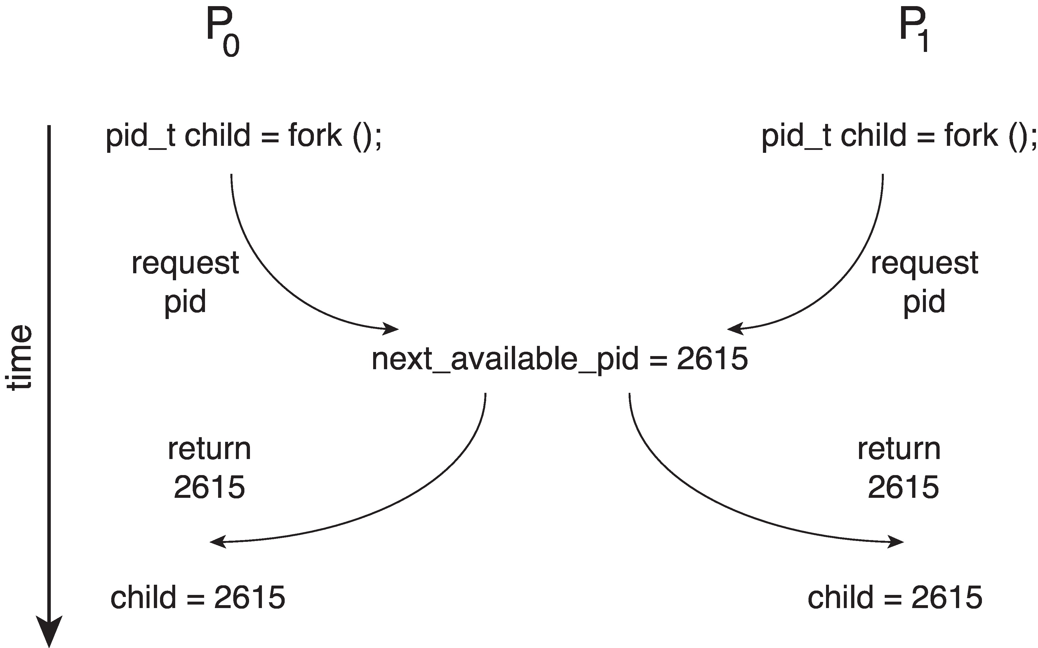
Race Condition Example
Processes P₀ and P₁ are creating child processs using the fork() system call
Race condition on kernel variable next_available_pid which represents the next available process identifier (pid)
Unless there is mutual exclusion, the same pid could be assigned to two different processes!
Notes:
Consider as an example a kernel data structure that maintains a list of all open files in the system. This list must be modified when a new file is opened or closed (adding the file to the list or removing it fromthe list). If two processes were to open files simultaneously, the separate updates to this list could result in a race condition.

Slide 7
Critical Section Problem
Consider a system of n processes {p₀, p₁, … p_{n-1}}
Each process has critical section segment of code
  Process may be changing common variables, updating table, writing file, etc
  When one process in critical section, no other may be in its critical section
Critical section problem is to design protocol to solve this
Each process must ask permission to enter critical section in entry section, may follow critical section with exit section, then remainder section

Slide 8

Critical Section
General structure of process P_{i}

Slide 9
Solution to Critical-Section (CS) Problem
Mutual Exclusion - If process P_{i} is executing in its CS, then no other processes can be executing in their CSs
  P_{i} gets exclusive access; others wait until P_{i} finishes
Progress - If no process is executing in its CS and there exist some processes that wish to enter their CS, then the selection of the processes that will enter the CS next cannot be postponed indefinitely
  Some P_{i} can always make progress (into the CS); no deadlock
Bounded Waiting - A bound must exist on the number of times that other processes are allowed to enter their critical sections after a process has made a request to enter its critical section and before that request is granted
  No one is kept waiting forever

Slide 10
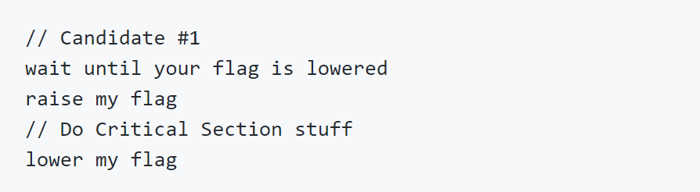
Candidate solutions #1
Idea: raising a flag means I’m going to enter the CS; lowering a flag means I’m done with the CS
Problem: does not satisfy Mutual Exclusion
  both processes could read each other's flag value (=lowered) and continue.

Slide 11
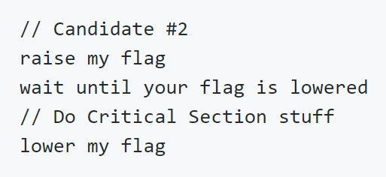
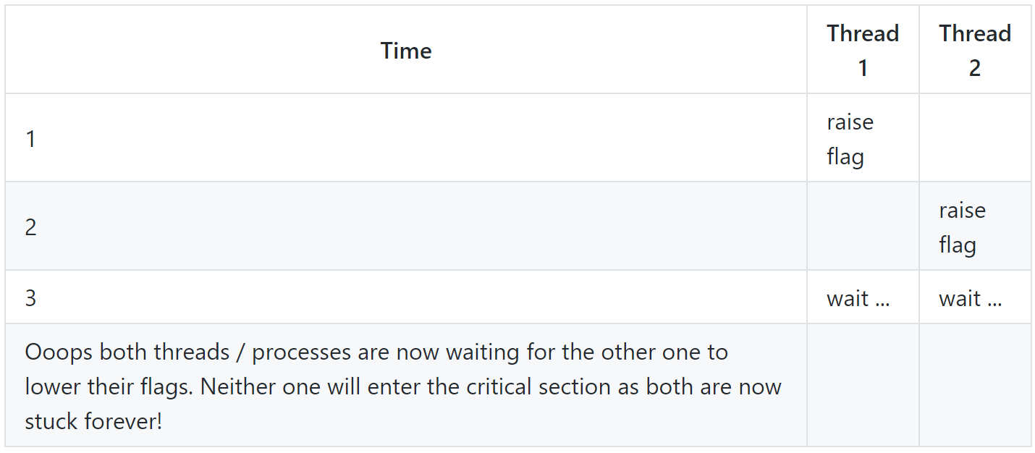
Candidate solutions #2
Idea: raise the flag before checking the other thread's flag
Satisfies mutual exclusion
But suffers from deadlock

Slide 12
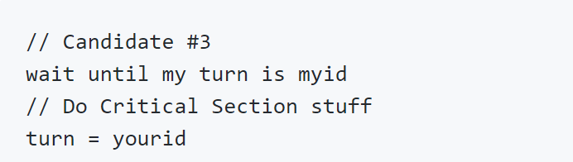
Candidate solutions #3
Idea: uses a turn-based variable to allow one thread and then the other to continue
satisfies mutual exclusion
however both processes are forced into an alternating critical section access pattern – possibly not effective

Slide 13
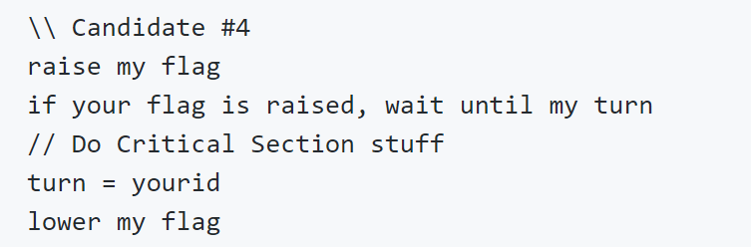
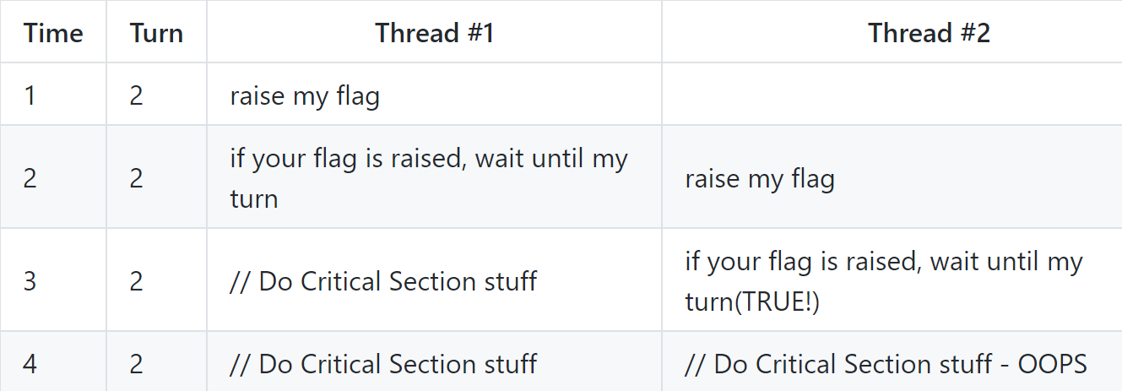
Candidate solutions #4
Idea: Turn + Flag
Violates mutual exclusion, unfortunately

Slide 14
Peterson’s Solution
The two processes share two variables:
  int turn;
  boolean flag[2]
The variable turn indicates whose turn it is to enter the critical section
The flag array is used to indicate if a process is ready to enter the critical section. flag[i] = true implies that process P_{i} is ready!

Slide 15
Algorithm for Process P_{i}
while (true){
flag[i] = true;
turn = j;
while (flag[j] && turn = = j)
;
/* critical section */
flag[i] = false;
/* remainder section */
}

Slide 16
Peterson’s Solution (Cont.)
Provable that the three CS requirement are met:
1. Mutual exclusion is preserved
P_{i} enters CS only if:
either flag[j] = false or turn = i
2. Progress requirement is satisfied
3. Bounded-waiting requirement is met

Slide 17
Peterson’s Solution
Does not guaranteed to work on modern architectures.
  Understanding why it will not work is also useful for better understanding race conditions.
To improve performance, processors and/or compilers may reorder operations that have no dependencies.
For single-threaded this is ok as the result will always be the same.
For multithreaded the reordering may produce inconsistent or unexpected results!

Slide 18
Peterson’s Solution
Two threads share the data:
boolean flag = false;
int x = 0;
Thread 1 performs
while (!flag)
;
print x
Thread 2 performs
x = 100;
flag = true
What is the expected output?

Slide 19
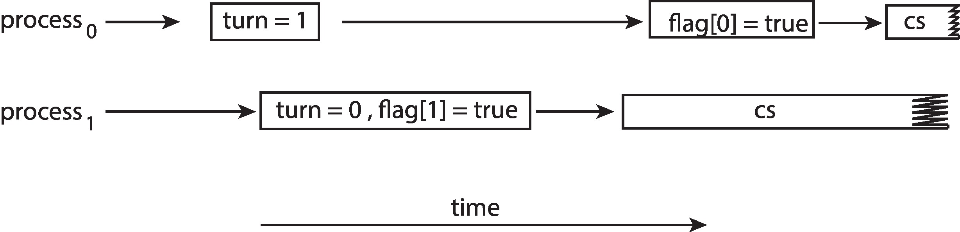
Peterson’s Solution
100 is the expected output.
However, the operations for Thread 2 may be reordered:
flag = true;
x = 100;
If this occurs, the output may be 0!
The effects of instruction reordering in Peterson’s Solution
This allows both processes to be in their CS at the same time!

Slide 20
Synchronization Hardware
Many systems provide hardware support for implementing the critical section code.
Uniprocessors – could disable interrupts
  Currently running code would execute without preemption
  Generally too inefficient on multiprocessor systems
    Operating systems using this not broadly scalable
We will look at three forms of hardware support:
1. Memory barriers
2. Hardware instructions
3. Atomic variables

Slide 21
Memory Barriers
Memory model are the memory guarantees a computer architecture makes to application programs.
A memory barrier is an instruction that
  forces any change in memory to be propagated (made visible) to all other processors.
  even if instructions were reordered, the memory barrier ensures that the store operations are completed in memory and visible to other processors before future load or store operations are performed
Notes:
内存屏障

Slide 22
Memory Barrier
We could add a memory barrier to the following instructions to ensure Thread 1 outputs 100:
Thread 1 now performs
while (!flag)
memory_barrier();
print x
  guarantee2 that the value of flag is loaded before the value of x.
Thread 2 now performs
x = 100;
memory_barrier();
flag = true
  ensure that the assignment to x occurs before the assignment to flag

Slide 23
Hardware Instructions
Special hardware instructions that allow us to either test-and-modify the content of a word, or two swap the contents of two words atomically (uninterruptibly.)
Test-and-Set instruction
Compare-and-Swap instruction

Slide 24
test_and_set Instruction
Definition:
boolean test_and_set (boolean *target)
{
boolean rv = *target;
*target = true;
return rv:
}
Executed atomically
Returns the original value of passed parameter
Set the new value of passed parameter to true

Slide 25
Solution using test_and_set()
Shared boolean variable lock, initialized to false
Solution:
do {
while (test_and_set(&lock))
; /* do nothing */
/* critical section */
lock = false;
/* remainder section */
} while (true);

Slide 26
compare_and_swap (CAS) Instruction
Definition:
int compare_and_swap(int *value, int expected, int new_value) {
int temp = *value;
//*value has not been modified before performing CAS
//so we follow what is expected to do： change the value
if (*value == expected)
*value = new_value;
//we return the old value or a value modified externally
return temp;
}
Executed atomically
Returns the original value of passed parameter value
Update *value only if *value == expected.
  Means that *value has not been modified by other processes
  And the swap then takes place (so consistency is ensured).

Slide 27
Solution using compare_and_swap
Shared integer lock initialized to 0;
Solution:
while (true){
while (compare_and_swap(&lock, 0, 1) != 0)
; /* do nothing */
/* critical section */
lock = 0;
/* remainder section */
}

Slide 28
Atomic Variables
Typically, instructions such as compare-and-swap are used as building blocks for other synchronization tools.
One tool is an atomic variable that provides atomic (uninterruptible) updates on basic data types such as integers and booleans.
For example, the increment() operation on the atomic variable sequence ensures sequence is incremented without interruption:
increment(&sequence);

Slide 29
Atomic Variables
The increment() function can be implemented as follows:
void increment(atomic_int *v)
{
int temp;
do {
temp = *v;
}
while (temp != (compare_and_swap(v,temp,temp+1));
}
Caution: *v might be changed
by another process here!
If *v is changed externally, CAS simply returns that changed value, so the loop would continue, meaning I’m going to try again. If *v is intact, then *v will increment (by temp+1) and the loop breaks.

Slide 30
Mutex Locks
Previous solutions are complicated and generally inaccessible to application programmers
OS designers build software tools to solve critical section problem
Simplest is mutex lock
Protect a critical section by first acquire() a lock then release() the lock
  Boolean variable indicating if lock is available or not
Calls to acquire() and release() must be atomic
  Usually implemented via hardware atomic instructions such as compare-and-swap.
But this solution requires busy waiting
  This lock therefore called a spinlock

Slide 31
Solution to CS Problem Using Locks
acquire() {
while (!available)
; /* busy wait */
available = false;;
}
release() {
available = true;
}
while (true) {
acquire lock
critical section
release lock
remainder section
}
These two functions must be implemented atomically.
Both test-and-set and compare-and-swap can be
used to implement these functions.

Slide 32
Semaphore
Provides more sophisticated ways (than Mutex locks) for process synchronization.
Semaphore S – integer variable, only accessed via two atomic operations
  wait() : decrement, block until semaphore is open
    Also P(), after the Dutch word for test, or down()
  signal(): increment, allow another thread to enter
    Also V() after the Dutch word for increment, or up()
Definition of wait()
  wait(S) {
  while (S <= 0)
  ; // busy wait
  S--;
  }
Definition of signal()
  signal(S) {
  S++;
  }

Slide 33
Semaphore Usage
Counting semaphore – range over an unrestricted domain
Binary semaphore – 0 or 1
  Same as a mutex lock
Can solve various synchronization problems
Consider P₁ and P₂ that require S₁ to happen before S₂
Create a semaphore “synch” initialized to 0
  P1:
  S₁;
  signal(synch);
  P2:
  wait(synch);
  S₂;
Can implement a counting semaphore S as a binary semaphore

Slide 34
Semaphore Implementation with no Busy waiting
With each semaphore there is an associated waiting queue
Two operations:
  block – place the process invoking the operation on the appropriate waiting queue
  wakeup – remove one of processes in the waiting queue and place it in the ready queue
typedef struct {
int value;
struct process *list;
} semaphore;

Slide 35
Implementation with no Busy waiting (Cont.)
wait(semaphore *S) {
S->value--;
if (S->value < 0) {
add this process to S->list;
block();
}
}
signal(semaphore *S) {
S->value++;
if (S->value <= 0) {
remove a process P from S->list;
wakeup(P);
}
}

Slide 36
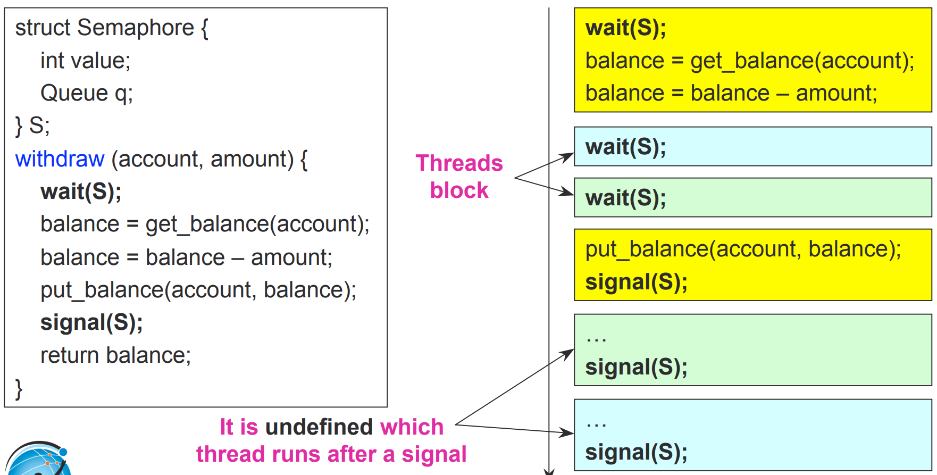
An example of Semaphore
From UCSD CSE 120 – Lecture 6

Slide 37
Problems with Semaphores
Can be used to solve any of the traditional synchronization problems
But provide no control of proper usage:
  signal (mutex) …. wait (mutex)
  wait (mutex) … wait (mutex)
  Omitting of wait (mutex) and/or signal (mutex)
They are essentially shared global variables – prone to bugs!
  Can potentially be accessed anywhere in program
  No connection between the semaphore and the data being controlled by the semaphore
  Sometimes hard to use
Another approach: Use programming language support

Slide 38
Monitors
A monitor is a programming language construct that controls access to shared data
  Synchronization code added by compiler, enforced at runtime
  Why is this an advantage?
A monitor is a module that encapsulates
  Shared data structures
  Procedures that operate on the shared data structures
  Synchronization between concurrent procedure invocations
A monitor protects its data from unstructured access
  A process can only access the variables through procedures
  Only one process may be active within the monitor
    If a second process invokes a monitor procedure, it waits
It guarantees that threads accessing its data through its procedures interact only in legitimate ways

Slide 39
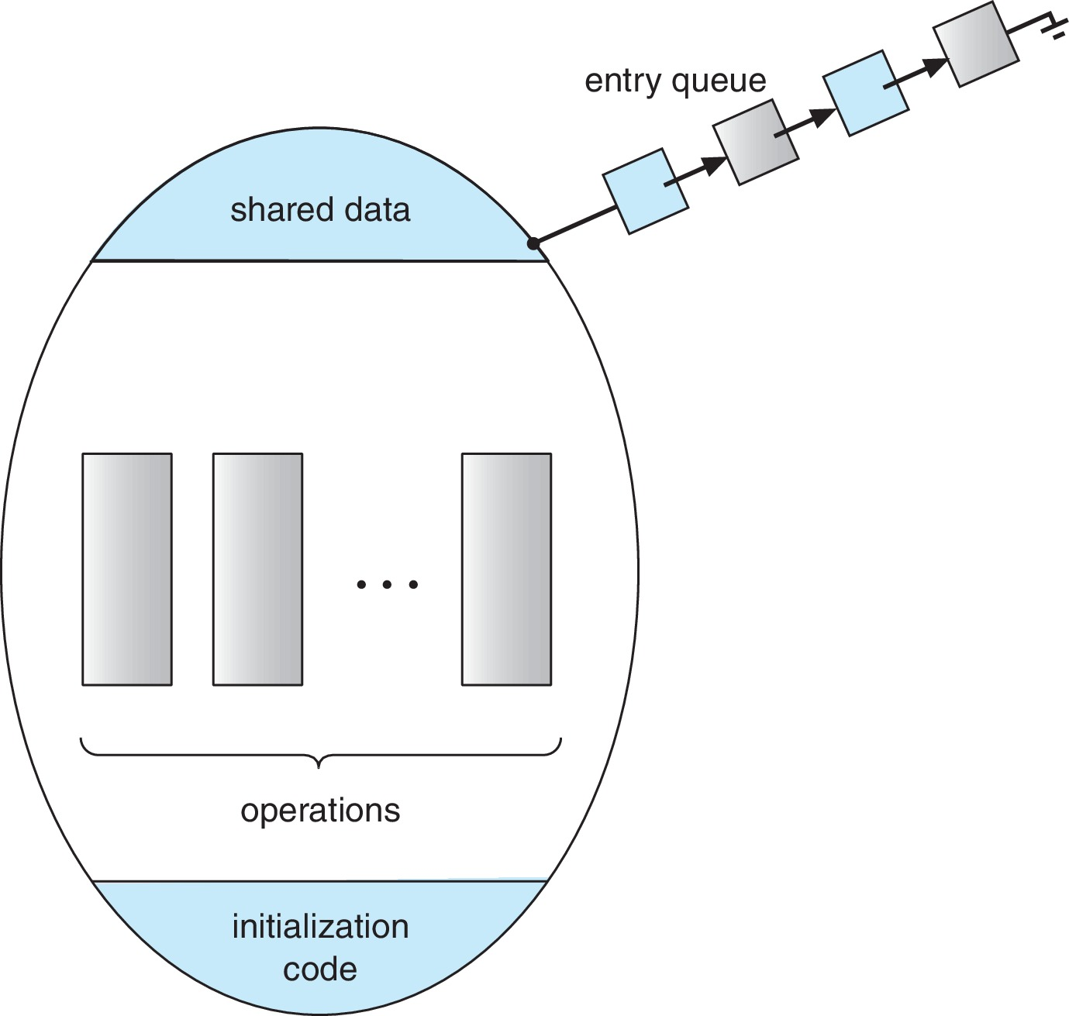
Schematic view of a Monitor
    monitor monitor-name
    {
    // shared variable declarations
    function P1 (…) { …. }
    function P2 (…) { …. }
    function Pn (…) {……}
    initialization code (…) { … }
    }

Slide 40
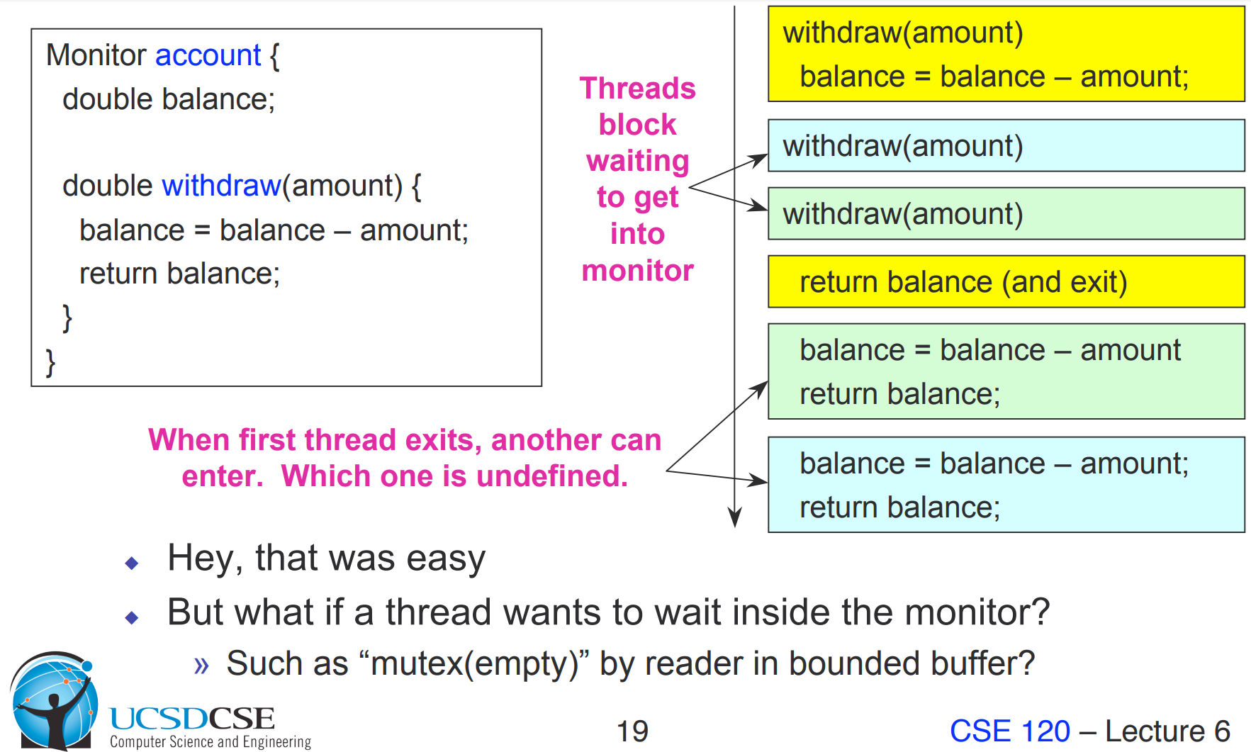
Account Example

Slide 41
Condition Variables
condition x, y;
Two operations are allowed on a condition variable:
  x.wait() – a process that invokes the operation is suspended until x.signal()
  x.signal() – resumes one of processes (if any) that invoked x.wait()
    If no x.wait() on the variable, then it has no effect on the variable

Slide 42
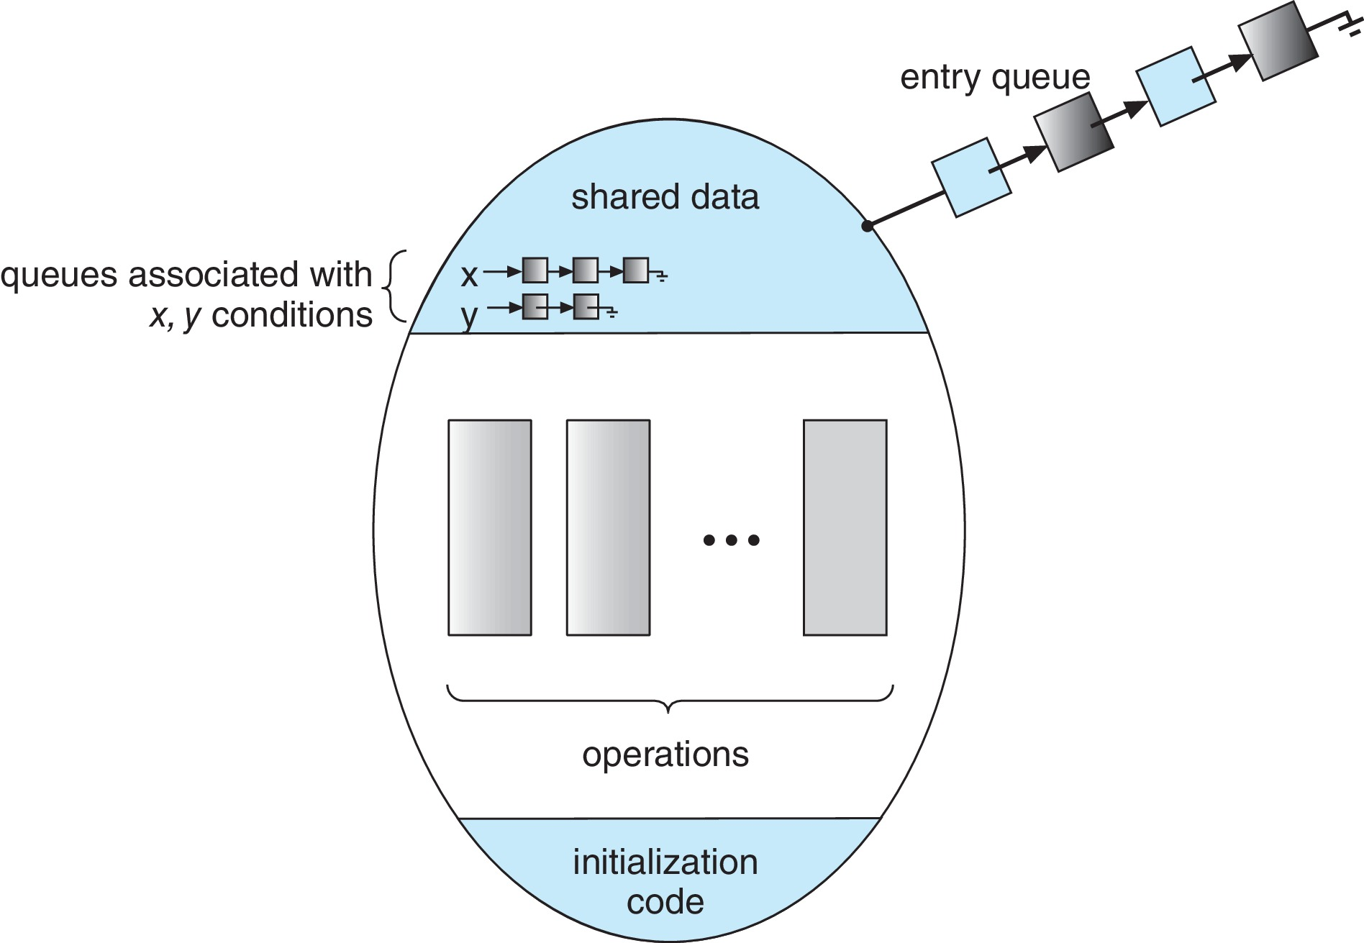
Monitor with Condition Variables

Slide 43
Condition Variables Choices
If process P invokes x.signal(), and process Q is suspended in x.wait(), what should happen next?
  Both Q and P cannot execute in paralel. If Q is resumed, then P must wait
Options include
  Signal and wait – P waits until Q either leaves the monitor or it waits for another condition
  Signal and continue – Q waits until P either leaves the monitor or it waits for another condition
  Both have pros and cons – language implementer can decide

Slide 44
Resuming Processes within a Monitor
If several processes queued on condition variable x, and x.signal() is executed, which process should be resumed?
FCFS frequently not adequate
conditional-wait construct of the form x.wait(c)
  Where c is priority number
  Process with lowest number (highest priority) is scheduled next

Slide 45
Single Resource allocation
Allocate a single resource among competing processes using priority numbers that specify the maximum time a process plans to use the resource
R.acquire(t);
...
access the resurce;
...
R.release;
Where R is an instance of type ResourceAllocator

Slide 46
A Monitor to Allocate Single Resource
monitor ResourceAllocator
{
boolean busy;
condition x;
void acquire(int time) {
if (busy)
x.wait(time);
busy = true;
}
void release() {
busy = FALSE;
x.signal();
}
initialization code() {
busy = false;
}
}

Slide 47
Liveness
Processes may have to wait indefinitely while trying to acquire a synchronization tool such as a mutex lock or semaphore.
Waiting indefinitely violates the progress and bounded-waiting criteria discussed at the beginning of this chapter.
Liveness refers to a set of properties that a system must satisfy to ensure processes make progress.
Indefinite waiting is an example of a liveness failure.

Slide 48
Liveness
Deadlock – two or more processes are waiting indefinitely for an event that can be caused by only one of the waiting processes
Let S and Q be two semaphores initialized to 1
P₀ P₁
wait(S); wait(Q);
wait(Q); wait(S);
... ...
signal(S); signal(Q);
signal(Q); signal(S);
Consider if P₀ executes wait(S) and P₁ wait(Q). When P₀ executes wait(Q), it must wait until P₁ executes signal(Q)
However, P₁ is waiting until P₀ execute signal(S).
Since these signal() operations will never be executed, P₀ and P₁ are deadlocked.

Slide 49
Liveness
Other forms of deadlock:
Starvation – indefinite blocking
  A process may never be removed from the semaphore queue in which it is suspended
Priority Inversion – Scheduling problem when lower-priority process holds a lock needed by higher-priority process
Solved via priority-inheritance protocol

Slide 50
Priority Inheritance Protocol
Consider three processes P1, P2, and P3.
  P1 has the highest priority, P2 the next, and P3 the lowest.
  Assume a resouce P3 is assigned a resource R that P1 wants. Thus, P1 must wait for P3 to finish using the resource.
  However, P2 becomes runnable and preempts P3
  P2 has indirectly prevented P3 from accessing the resource.
To prevent this from occurring, a priority inheritance protocol is used.
  Allows the priority of the highest thread waiting to access a shared resource to be assigned to the thread currently using the resource.
  Thus, the current owner of the resource is assigned the priority of the highest priority thread wishing to acquire the resource.

Slide 51
Homework （10th edition)
6.13, 6.33

Slide 52
End of Chapter 6

